Slide 1
BST – User Defined Class
Tree Node + Object
Begin at page 116

Slide 2
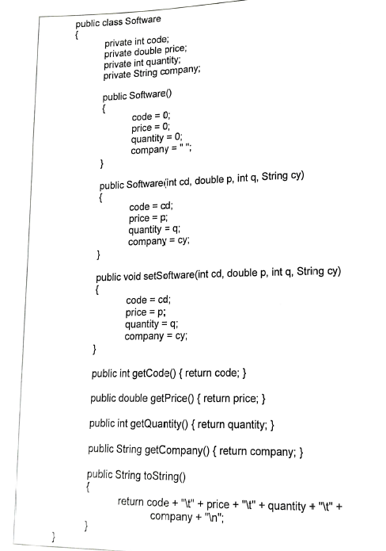
Class Software
Pg 116

Slide 3
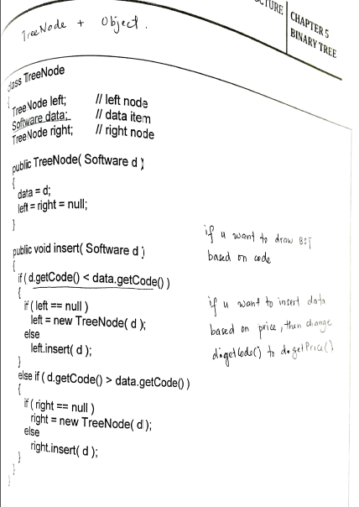
Class TreeNode +
Object
Pg 117

Slide 4
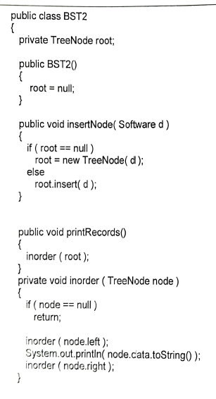
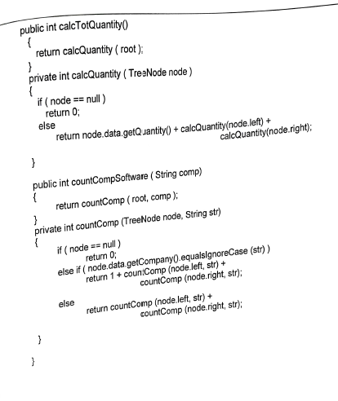
Class BST2
Pg 118 & 119

Slide 5
Pg 120

Slide 6

Pg 120
Rule :
root
< root
>= root

Slide 7
Do yourself. The final tree
108
106
112
105
107
109
114
104

Slide 8
Insert object into TreeNode
Pg 93 & 94

Slide 9
Insert object into TreeNode
Software
code = 108 price = 600 quantity = 50 company = Borland

Slide 10
Insert object into TreeNode
left | Software | right
 | code = 108 price = 600 quantity = 50 company = Borland
public void insertNode(Software d)
{
if(root == null)
root = new TreeNode(d)
else
root.insert(d)
}
null
null
Class TreeNode
Class BST2

Slide 11
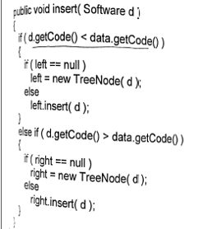
left | Software | right
 | code = 108 price = 600 quantity = 50 company = Borland
public void insertNode(Software d)
{
if(root == null)
root = new TreeNode(d)
else
root.insert(d)
}
Class BST2
left | Software | right
 | code = 106 price = 650 quantity = 100 company = Microsoft
null
null
null
Class TreeNode

Slide 12
left | Software | right
 | code = 108 price = 600 quantity = 50 company = Borland
public void insertNode(Software d)
{
if(root == null)
root = new TreeNode(d)
else
root.insert(d)
}
Class BST2
left | Software | right
 | code = 106 price = 650 quantity = 100 company = Microsoft
null
left | Software | right
 | code = 105 price = 550 quantity = 120 company = Borland
null
Class TreeNode
null
null

Slide 13
left | Software | right
 | code = 108 price = 600 quantity = 50 company = Borland
public void insertNode(Software d)
{
if(root == null)
root = new TreeNode(d)
else
root.insert(d)
}
Class BST2
left | Software | right
 | code = 106 price = 650 quantity = 100 company = Microsoft
left | Software | right
 | code = 112 price = 950 quantity = 140 company = Borland
left | Software | right
 | code = 105 price = 550 quantity = 120 company = Borland
null
null
null
Class TreeNode
null
null

Slide 14
left | Software | right
 | code = 108 price = 600 quantity = 50 company = Borland
left | Software | right
 | code = 106 price = 650 quantity = 100 company = Microsoft
left | Software | right
 | code = 112 price = 950 quantity = 140 company = Borland
left | Software | right
 | code = 105 price = 550 quantity = 120 company = Borland
left | Software | right
 | code = 107 price = 500 quantity = 150 company = Microsoft
null
null
null
null
null
null

Slide 15
left | Software | right
 | code = 108 price = 600 quantity = 50 company = Borland
left | Software | right
 | code = 106 price = 650 quantity = 100 company = Microsoft
left | Software | right
 | code = 112 price = 950 quantity = 140 company = Borland
left | Software | right
 | code = 105 price = 550 quantity = 120 company = Borland
left | Software | right
 | code = 107 price = 500 quantity = 150 company = Microsoft
null
null
left | Software | right
 | code = 104 price = 1000 quantity = 90 company = Microsoft
null
null
null
null
null

Slide 16
left | Software | right
 | code = 108 price = 600 quantity = 50 company = Borland
left | Software | right
 | code = 106 price = 650 quantity = 100 company = Microsoft
left | Software | right
 | code = 112 price = 950 quantity = 140 company = Borland
left | Software | right
 | code = 105 price = 550 quantity = 120 company = Borland
left | Software | right
 | code = 107 price = 500 quantity = 150 company = Microsoft
left | Software | right
 | code = 109 price = 800 quantity = 80 company = Turbo
null
left | Software | right
 | code = 104 price = 1000 quantity = 90 company = Microsoft
null
null
null
null
null
null
null

Slide 17
left | Software | right
 | code = 108 price = 600 quantity = 50 company = Borland
left | Software | right
 | code = 106 price = 650 quantity = 100 company = Microsoft
left | Software | right
 | code = 112 price = 950 quantity = 140 company = Borland
left | Software | right
 | code = 105 price = 550 quantity = 120 company = Borland
left | Software | right
 | code = 107 price = 500 quantity = 150 company = Microsoft
left | Software | right
 | code = 109 price = 800 quantity = 80 company = Turbo
left | Software | right
 | code = 114 price = 700 quantity = 100 company = Turbo
left | Software | right
 | code = 104 price = 1000 quantity = 90 company = Microsoft
null
null
null
null
null
null
null
null
null

Slide 18
left | Software | right
 | code = 108 price = 600 quantity = 50 company = Borland
left | Software | right
 | code = 106 price = 650 quantity = 100 company = Microsoft
left | Software | right
 | code = 112 price = 950 quantity = 140 company = Borland
left | Software | right
 | code = 105 price = 550 quantity = 120 company = Borland
left | Software | right
 | code = 107 price = 500 quantity = 150 company = Microsoft
left | Software | right
 | code = 109 price = 800 quantity = 80 company = Turbo
left | Software | right
 | code = 114 price = 700 quantity = 100 company = Turbo
left | Software | right
 | code = 104 price = 1000 quantity = 90 company = Microsoft
null
null
null
null
null
null
null
null
null

Slide 19
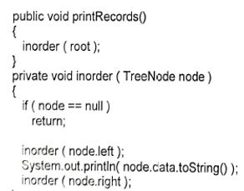
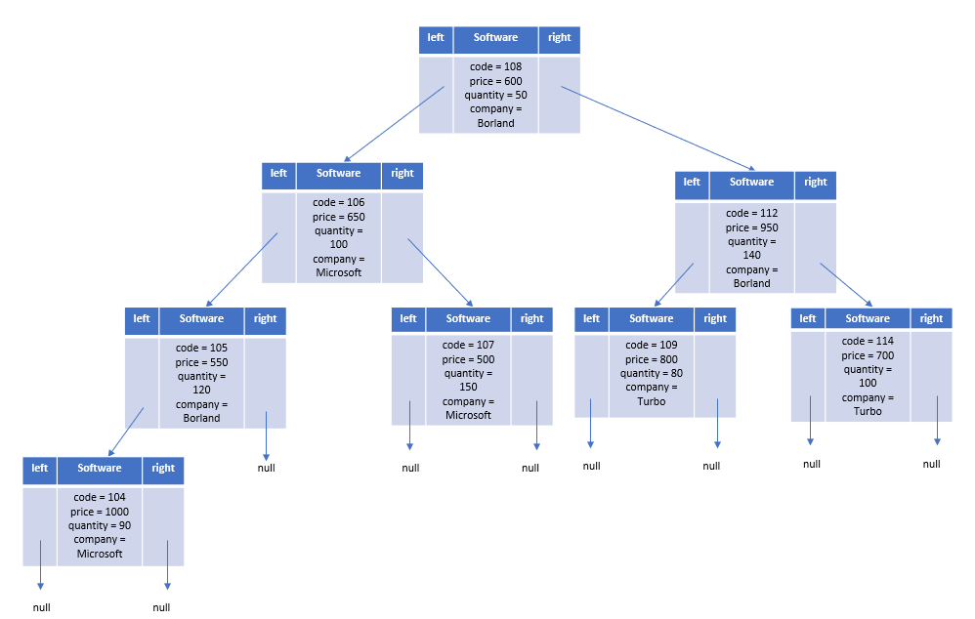
Print the list of all software: Trace yourself

Slide 20
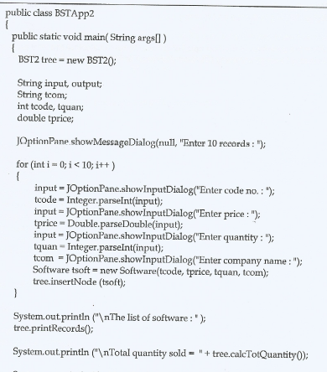
Print the total quantity sold for all software
Pg 94

Slide 21
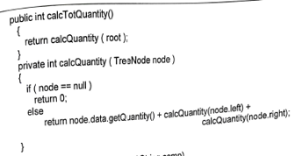
Print the total quantity sold for all software
Pg 94

Slide 22
Print the total quantity sold for all software
root

Slide 23
Print the total quantity sold for all software
node
root

Slide 24
Print the total quantity sold for all software
node
root
X

Slide 25
Print the total quantity sold for all software
node
root
code: 108
code: 106
code: 112
return node.data.getQuantity + calcQuantity(node.left) + calcQuantity(node.right)
50 +

Slide 26
node
root
code: 106
code: 112
return node.data.getQuantity + calcQuantity(node.left) + calcQuantity(node.right)
code: 105
code: 107
return node.data.getQuantity + calcQuantity(node.left) + calcQuantity(node.right)
50 + 100

Slide 27
root
node
code: 112
return node.data.getQuantity + calcQuantity(node.left) + calcQuantity(node.right)
code: 105
code: 107
return node.data.getQuantity + calcQuantity(node.left) + calcQuantity(node.right)
code: 104
code: null
return node.data.getQuantity + calcQuantity(node.left) + calcQuantity(node.right)
50 + 100 + 120

Slide 28
root
node
code: 112
return node.data.getQuantity + calcQuantity(node.left) + calcQuantity(node.right)
code: 107
return node.data.getQuantity + calcQuantity(node.left) + calcQuantity(node.right)
code: 104
code: null
return node.data.getQuantity + calcQuantity(node.left) + calcQuantity(node.right)
code: null
code: null
return node.data.getQuantity + calcQuantity(node.left) + calcQuantity(node.right)
50 + 100 + 120 + 90

Slide 29
root
code: 112
return node.data.getQuantity + calcQuantity(node.left) + calcQuantity(node.right)
code: 107
node
return node.data.getQuantity + calcQuantity(node.left) + calcQuantity(node.right)
code: null
return node.data.getQuantity + calcQuantity(node.left) + calcQuantity(node.right)
code: null
code: null
return node.data.getQuantity + calcQuantity(node.left) + calcQuantity(node.right)
50 + 100 + 120 + 90 + 0

Slide 30
root
code: 112
return node.data.getQuantity + calcQuantity(node.left) + calcQuantity(node.right)
code: 107
node
return node.data.getQuantity + calcQuantity(node.left) + calcQuantity(node.right)
code: null
return node.data.getQuantity + calcQuantity(node.left) + calcQuantity(node.right)
code: null
return node.data.getQuantity + calcQuantity(node.left) + calcQuantity(node.right)
50 + 100 + 120 + 90 + 0 + 0

Slide 31
root
code: 112
We remove this part because of limitation of space
return node.data.getQuantity + calcQuantity(node.left) + calcQuantity(node.right)
code: 107
node
return node.data.getQuantity + calcQuantity(node.left) + calcQuantity(node.right)
code: null
return node.data.getQuantity + calcQuantity(node.left) + calcQuantity(node.right)
return node.data.getQuantity + calcQuantity(node.left) + calcQuantity(node.right)
50 + 100 + 120 + 90 + 0 + 0

Slide 32
root
code: 112
return node.data.getQuantity + calcQuantity(node.left) + calcQuantity(node.right)
code: 107
node
return node.data.getQuantity + calcQuantity(node.left) + calcQuantity(node.right)
code: null
return node.data.getQuantity + calcQuantity(node.left) + calcQuantity(node.right)
50 + 100 + 120 + 90 + 0 + 0

Slide 33
root
node
code: 112
return node.data.getQuantity + calcQuantity(node.left) + calcQuantity(node.right)
code: 107
return node.data.getQuantity + calcQuantity(node.left) + calcQuantity(node.right)
code: null
return node.data.getQuantity + calcQuantity(node.left) + calcQuantity(node.right)
50 + 100 + 120 + 90 + 0 + 0 + 0

Slide 34
root
We remove this part because of limitation of space
node
code: 112
return node.data.getQuantity + calcQuantity(node.left) + calcQuantity(node.right)
code: 107
return node.data.getQuantity + calcQuantity(node.left) + calcQuantity(node.right)
code: null
return node.data.getQuantity + calcQuantity(node.left) + calcQuantity(node.right)
50 + 100 + 120 + 90 + 0 + 0 + 0

Slide 35
root
node
code: 112
return node.data.getQuantity + calcQuantity(node.left) + calcQuantity(node.right)
code: 107
return node.data.getQuantity + calcQuantity(node.left) + calcQuantity(node.right)
50 + 100 + 120 + 90 + 0 + 0 + 0

Slide 36
root
node
code: 112
return node.data.getQuantity + calcQuantity(node.left) + calcQuantity(node.right)
code: 107
return node.data.getQuantity + calcQuantity(node.left) + calcQuantity(node.right)
code: null
code: null
return node.data.getQuantity + calcQuantity(node.left) + calcQuantity(node.right)
50 + 100 + 120 + 90 + 0 + 0 + 0 + 150

Slide 37
root
node
code: 112
return node.data.getQuantity + calcQuantity(node.left) + calcQuantity(node.right)
return node.data.getQuantity + calcQuantity(node.left) + calcQuantity(node.right)
code: null
code: null
return node.data.getQuantity + calcQuantity(node.left) + calcQuantity(node.right)
50 + 100 + 120 + 90 + 0 + 0 + 0 + 150 + 0

Slide 38
root
node
code: 112
return node.data.getQuantity + calcQuantity(node.left) + calcQuantity(node.right)
return node.data.getQuantity + calcQuantity(node.left) + calcQuantity(node.right)
code: null
return node.data.getQuantity + calcQuantity(node.left) + calcQuantity(node.right)
50 + 100 + 120 + 90 + 0 + 0 + 0 + 150 + 0 + 0

Slide 39
root
We remove this part because of limitation of space
node
code: 112
return node.data.getQuantity + calcQuantity(node.left) + calcQuantity(node.right)
return node.data.getQuantity + calcQuantity(node.left) + calcQuantity(node.right)
code: null
return node.data.getQuantity + calcQuantity(node.left) + calcQuantity(node.right)
50 + 100 + 120 + 90 + 0 + 0 + 0 + 150 + 0 + 0

Slide 40
root
node
code: 112
return node.data.getQuantity + calcQuantity(node.left) + calcQuantity(node.right)
50 + 100 + 120 + 90 + 0 + 0 + 0 + 150 + 0 + 0

Slide 41
root
node
code: 112
return node.data.getQuantity + calcQuantity(node.left) + calcQuantity(node.right)
code: 109
code: 114
return node.data.getQuantity + calcQuantity(node.left) + calcQuantity(node.right)
50 + 100 + 120 + 90 + 0 + 0 + 0 + 150 + 0 + 0 + 140

Slide 42
root
node
return node.data.getQuantity + calcQuantity(node.left) + calcQuantity(node.right)
code: 109
code: 114
return node.data.getQuantity + calcQuantity(node.left) + calcQuantity(node.right)
code: null
code: null
return node.data.getQuantity + calcQuantity(node.left) + calcQuantity(node.right)
50 + 100 + 120 + 90 + 0 + 0 + 0 + 150 + 0 + 0 + 140 + 80

Slide 43
root
node
return node.data.getQuantity + calcQuantity(node.left) + calcQuantity(node.right)
code: 114
return node.data.getQuantity + calcQuantity(node.left) + calcQuantity(node.right)
code: null
code: null
return node.data.getQuantity + calcQuantity(node.left) + calcQuantity(node.right)
50 + 100 + 120 + 90 + 0 + 0 + 0 + 150 + 0 + 0 + 140 + 80 + 0

Slide 44
root
node
return node.data.getQuantity + calcQuantity(node.left) + calcQuantity(node.right)
code: 114
return node.data.getQuantity + calcQuantity(node.left) + calcQuantity(node.right)
code: null
return node.data.getQuantity + calcQuantity(node.left) + calcQuantity(node.right)
50 + 100 + 120 + 90 + 0 + 0 + 0 + 150 + 0 + 0 + 140 + 80 + 0 + 0

Slide 45
root
We remove this part because of limitation of space
node
return node.data.getQuantity + calcQuantity(node.left) + calcQuantity(node.right)
code: 114
return node.data.getQuantity + calcQuantity(node.left) + calcQuantity(node.right)
code: null
return node.data.getQuantity + calcQuantity(node.left) + calcQuantity(node.right)
50 + 100 + 120 + 90 + 0 + 0 + 0 + 150 + 0 + 0 + 140 + 80 + 0 + 0

Slide 46
root
node
return node.data.getQuantity + calcQuantity(node.left) + calcQuantity(node.right)
code: 114
return node.data.getQuantity + calcQuantity(node.left) + calcQuantity(node.right)
50 + 100 + 120 + 90 + 0 + 0 + 0 + 150 + 0 + 0 + 140 + 80 + 0 + 0

Slide 47
root
node
return node.data.getQuantity + calcQuantity(node.left) + calcQuantity(node.right)
code: 114
return node.data.getQuantity + calcQuantity(node.left) + calcQuantity(node.right)
code: null
code: null
return node.data.getQuantity + calcQuantity(node.left) + calcQuantity(node.right)
50 + 100 + 120 + 90 + 0 + 0 + 0 + 150 + 0 + 0 + 140 + 80 + 0 + 0 + 100

Slide 48
root
node
return node.data.getQuantity + calcQuantity(node.left) + calcQuantity(node.right)
return node.data.getQuantity + calcQuantity(node.left) + calcQuantity(node.right)
code: null
code: null
return node.data.getQuantity + calcQuantity(node.left) + calcQuantity(node.right)
50 + 100 + 120 + 90 + 0 + 0 + 0 + 150 + 0 + 0 + 140 + 80 + 0 + 0 + 100 + 0

Slide 49
root
node
return node.data.getQuantity + calcQuantity(node.left) + calcQuantity(node.right)
return node.data.getQuantity + calcQuantity(node.left) + calcQuantity(node.right)
code: null
return node.data.getQuantity + calcQuantity(node.left) + calcQuantity(node.right)
50 + 100 + 120 + 90 + 0 + 0 + 0 + 150 + 0 + 0 + 140 + 80 + 0 + 0 + 100 + 0 + 0

Slide 50
root
node
return node.data.getQuantity + calcQuantity(node.left) + calcQuantity(node.right)
return node.data.getQuantity + calcQuantity(node.left) + calcQuantity(node.right)
return node.data.getQuantity + calcQuantity(node.left) + calcQuantity(node.right)
50 + 100 + 120 + 90 + 0 + 0 + 0 + 150 + 0 + 0 + 140 + 80 + 0 + 0 + 100 + 0 + 0 = 830

Slide 51
root
node
return node.data.getQuantity + calcQuantity(node.left) + calcQuantity(node.right)
return node.data.getQuantity + calcQuantity(node.left) + calcQuantity(node.right)
return node.data.getQuantity + calcQuantity(node.left) + calcQuantity(node.right)
50 + 100 + 120 + 90 + 0 + 0 + 0 + 150 + 0 + 0 + 140 + 80 + 0 + 0 + 100 + 0 + 0 = 830
Total quantity sold = 830

Slide 52
Print the total quantity sold for all software in the list

Slide 53
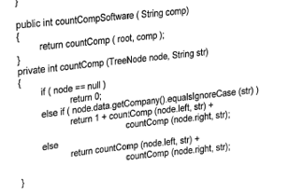
Print the total quantity sold for all software in the list
Example: Company = Borland

Slide 54
Company = Borland
root

Slide 55
Company = Borland
comp = Borland
root

Slide 56
Company = Borland
comp = Borland
root

Slide 57
Company = Borland
comp = Borland
node
root
str = Borland

Slide 58
Company = Borland
comp = Borland
node
root
str = Borland
if | else if | else
F

Slide 59
Company = Borland
comp = Borland
node
root
str = Borland
if | else if | else
F | T
code: 106
code: 112
return 1 + countComp(node.left, str) + countComp(node.right, str)
1

Slide 60
Company = Borland
comp = Borland
node
root
str = Borland
if | else if | else
code: 106
code: 112
return 1 + countComp(node.left, str) + countComp(node.right, str)
1

Slide 61
Company = Borland
comp = Borland
node
root
str = Borland
if | else if | else
F
code: 106
code: 112
return 1 + countComp(node.left, str) + countComp(node.right, str)
1

Slide 62
Company = Borland
comp = Borland
node
root
str = Borland
if | else if | else
F | F
code: 106
code: 112
return 1 + countComp(node.left, str) + countComp(node.right, str)
1

Slide 63
Company = Borland
comp = Borland
node
root
str = Borland
if | else if | else
F | F | T
code: 106
code: 112
return 1 + countComp(node.left, str) + countComp(node.right, str)
1

Slide 64
Company = Borland
comp = Borland
node
root
str = Borland
if | else if | else
F | F | T
code: 106
code: 112
return 1 + countComp(node.left, str) + countComp(node.right, str)
code: 105
code: 107
return countComp(node.left, str) + countComp(node.right, str)
1

Slide 65
Company = Borland
comp = Borland
root
str = Borland
node
if | else if | else
code: 112
return 1 + countComp(node.left, str) + countComp(node.right, str)
code: 105
code: 107
return countComp(node.left, str) + countComp(node.right, str)
1

Slide 66
Company = Borland
comp = Borland
root
str = Borland
node
if | else if | else
F
code: 112
return 1 + countComp(node.left, str) + countComp(node.right, str)
code: 105
code: 107
return countComp(node.left, str) + countComp(node.right, str)
1

Slide 67
Company = Borland
comp = Borland
root
str = Borland
node
if | else if | else
F | T
code: 112
return 1 + countComp(node.left, str) + countComp(node.right, str)
code: 105
code: 107
return countComp(node.left, str) + countComp(node.right, str)
1

Slide 68
Company = Borland
comp = Borland
root
str = Borland
node
if | else if | else
F | T
code: 112
return 1 + countComp(node.left, str) + countComp(node.right, str)
code: 105
code: 107
return countComp(node.left, str) + countComp(node.right, str)
code: 104
code: null
return 1 + countComp(node.left, str) + countComp(node.right, str)
1 + 1

Slide 69
Company = Borland
comp = Borland
root
str = Borland
node
if | else if | else
code: 112
return 1 + countComp(node.left, str) + countComp(node.right, str)
code: 107
return countComp(node.left, str) + countComp(node.right, str)
code: 104
code: null
return 1 + countComp(node.left, str) + countComp(node.right, str)
1 + 1

Slide 70
Company = Borland
comp = Borland
root
str = Borland
node
if | else if | else
F
code: 112
return 1 + countComp(node.left, str) + countComp(node.right, str)
code: 107
return countComp(node.left, str) + countComp(node.right, str)
code: 104
code: null
return 1 + countComp(node.left, str) + countComp(node.right, str)
1 + 1

Slide 71
Company = Borland
comp = Borland
root
str = Borland
node
if | else if | else
F | F
code: 112
return 1 + countComp(node.left, str) + countComp(node.right, str)
code: 107
return countComp(node.left, str) + countComp(node.right, str)
code: 104
code: null
return 1 + countComp(node.left, str) + countComp(node.right, str)
1 + 1

Slide 72
Company = Borland
comp = Borland
root
str = Borland
node
if | else if | else
F | F | T
code: 112
return 1 + countComp(node.left, str) + countComp(node.right, str)
code: 107
return countComp(node.left, str) + countComp(node.right, str)
code: 104
code: null
return 1 + countComp(node.left, str) + countComp(node.right, str)
code: null
code: null
return countComp(node.left, str) + countComp(node.right, str)
1 + 1

Slide 73
Company = Borland
comp = Borland
root
str = Borland
if | else if | else
code: 112
return 1 + countComp(node.left, str) + countComp(node.right, str)
code: 107
node
return countComp(node.left, str) + countComp(node.right, str)
code: null
return 1 + countComp(node.left, str) + countComp(node.right, str)
code: null
code: null
return countComp(node.left, str) + countComp(node.right, str)
1 + 1

Slide 74
Company = Borland
comp = Borland
root
str = Borland
if | else if | else
T
code: 112
return 1 + countComp(node.left, str) + countComp(node.right, str)
code: 107
node
return countComp(node.left, str) + countComp(node.right, str)
code: null
return 1 + countComp(node.left, str) + countComp(node.right, str)
code: null
code: null
return countComp(node.left, str) + countComp(node.right, str)
1 + 1

Slide 75
Company = Borland
comp = Borland
root
str = Borland
if | else if | else
T
code: 112
return 1 + countComp(node.left, str) + countComp(node.right, str)
code: 107
node
return countComp(node.left, str) + countComp(node.right, str)
code: null
return 1 + countComp(node.left, str) + countComp(node.right, str)
code: null
code: null
return countComp(node.left, str) + countComp(node.right, str)
1 + 1 + 0

Slide 76
Company = Borland
comp = Borland
root
str = Borland
if | else if | else
T
code: 112
return 1 + countComp(node.left, str) + countComp(node.right, str)
code: 107
node
return countComp(node.left, str) + countComp(node.right, str)
code: null
return 1 + countComp(node.left, str) + countComp(node.right, str)
code: null
return countComp(node.left, str) + countComp(node.right, str)
1 + 1 + 0

Slide 77
Company = Borland
comp = Borland
root
str = Borland
if | else if | else
T
code: 112
return 1 + countComp(node.left, str) + countComp(node.right, str)
code: 107
node
return countComp(node.left, str) + countComp(node.right, str)
code: null
return 1 + countComp(node.left, str) + countComp(node.right, str)
code: null
return countComp(node.left, str) + countComp(node.right, str)
1 + 1 + 0 + 0

Slide 78
Company = Borland
comp = Borland
root
str = Borland
if | else if | else
T
code: 112
We remove this part because of limitation of space
return 1 + countComp(node.left, str) + countComp(node.right, str)
code: 107
node
return countComp(node.left, str) + countComp(node.right, str)
code: null
return 1 + countComp(node.left, str) + countComp(node.right, str)
code: null
return countComp(node.left, str) + countComp(node.right, str)
1 + 1 + 0 + 0

Slide 79
Company = Borland
comp = Borland
root
str = Borland
code: 112
return 1 + countComp(node.left, str) + countComp(node.right, str)
code: 107
node
return countComp(node.left, str) + countComp(node.right, str)
code: null
return 1 + countComp(node.left, str) + countComp(node.right, str)
1 + 1 + 0 + 0

Slide 80
Company = Borland
comp = Borland
root
str = Borland
if | else if | else
node
code: 112
return 1 + countComp(node.left, str) + countComp(node.right, str)
code: 107
return countComp(node.left, str) + countComp(node.right, str)
code: null
return 1 + countComp(node.left, str) + countComp(node.right, str)
1 + 1 + 0 + 0

Slide 81
Company = Borland
comp = Borland
root
str = Borland
if | else if | else
T
node
code: 112
return 1 + countComp(node.left, str) + countComp(node.right, str)
code: 107
return countComp(node.left, str) + countComp(node.right, str)
code: null
return 1 + countComp(node.left, str) + countComp(node.right, str)
1 + 1 + 0 + 0 + 0

Slide 82
Company = Borland
comp = Borland
root
str = Borland
We remove this part because of limitation of space
if | else if | else
T
node
code: 112
return 1 + countComp(node.left, str) + countComp(node.right, str)
code: 107
return countComp(node.left, str) + countComp(node.right, str)
code: null
return 1 + countComp(node.left, str) + countComp(node.right, str)
1 + 1 + 0 + 0 + 0

Slide 83
Company = Borland
comp = Borland
root
str = Borland
node
code: 112
return 1 + countComp(node.left, str) + countComp(node.right, str)
code: 107
return countComp(node.left, str) + countComp(node.right, str)
1 + 1 + 0 + 0 + 0

Slide 84
Company = Borland
comp = Borland
root
str = Borland
if | else if | else
node
code: 112
return 1 + countComp(node.left, str) + countComp(node.right, str)
code: 107
return countComp(node.left, str) + countComp(node.right, str)
1 + 1 + 0 + 0 + 0

Slide 85
Company = Borland
comp = Borland
root
str = Borland
if | else if | else
F
node
code: 112
return 1 + countComp(node.left, str) + countComp(node.right, str)
code: 107
return countComp(node.left, str) + countComp(node.right, str)
1 + 1 + 0 + 0 + 0

Slide 86
Company = Borland
comp = Borland
root
str = Borland
if | else if | else
F | F
node
code: 112
return 1 + countComp(node.left, str) + countComp(node.right, str)
code: 107
return countComp(node.left, str) + countComp(node.right, str)
1 + 1 + 0 + 0 + 0

Slide 87
Company = Borland
comp = Borland
root
str = Borland
if | else if | else
F | F | T
node
code: 112
return 1 + countComp(node.left, str) + countComp(node.right, str)
code: 107
return countComp(node.left, str) + countComp(node.right, str)
code: null
code: null
return countComp(node.left, str) + countComp(node.right, str)
1 + 1 + 0 + 0 + 0

Slide 88
Company = Borland
comp = Borland
root
str = Borland
if | else if | else
node
code: 112
return 1 + countComp(node.left, str) + countComp(node.right, str)
return countComp(node.left, str) + countComp(node.right, str)
code: null
code: null
return countComp(node.left, str) + countComp(node.right, str)
1 + 1 + 0 + 0 + 0

Slide 89
Company = Borland
comp = Borland
root
str = Borland
if | else if | else
T
node
code: 112
return 1 + countComp(node.left, str) + countComp(node.right, str)
return countComp(node.left, str) + countComp(node.right, str)
code: null
code: null
return countComp(node.left, str) + countComp(node.right, str)
1 + 1 + 0 + 0 + 0 + 0

Slide 90
Company = Borland
comp = Borland
root
str = Borland
if | else if | else
node
code: 112
return 1 + countComp(node.left, str) + countComp(node.right, str)
return countComp(node.left, str) + countComp(node.right, str)
code: null
return countComp(node.left, str) + countComp(node.right, str)
1 + 1 + 0 + 0 + 0 + 0 + 0

Slide 91
Company = Borland
comp = Borland
root
str = Borland
if | else if | else
T
node
code: 112
return 1 + countComp(node.left, str) + countComp(node.right, str)
return countComp(node.left, str) + countComp(node.right, str)
code: null
return countComp(node.left, str) + countComp(node.right, str)
1 + 1 + 0 + 0 + 0 + 0 + 0

Slide 92
Company = Borland
comp = Borland
root
str = Borland
We remove this part because of limitation of space
node
code: 112
return 1 + countComp(node.left, str) + countComp(node.right, str)
return countComp(node.left, str) + countComp(node.right, str)
return countComp(node.left, str) + countComp(node.right, str)
1 + 1 + 0 + 0 + 0 + 0 + 0

Slide 93
Company = Borland
comp = Borland
root
str = Borland
node
code: 112
return 1 + countComp(node.left, str) + countComp(node.right, str)
1 + 1 + 0 + 0 + 0 + 0 + 0

Slide 94
Company = Borland
comp = Borland
root
node
str = Borland
code: 112
return 1 + countComp(node.left, str) + countComp(node.right, str)
1 + 1 + 0 + 0 + 0 + 0 + 0

Slide 95
Company = Borland
comp = Borland
root
node
str = Borland
if | else if | else
F
code: 112
return 1 + countComp(node.left, str) + countComp(node.right, str)
1 + 1 + 0 + 0 + 0 + 0 + 0

Slide 96
Company = Borland
comp = Borland
root
node
str = Borland
if | else if | else
F | T
code: 112
return 1 + countComp(node.left, str) + countComp(node.right, str)
code: 109
code: 114
return 1 + countComp(node.left, str) + countComp(node.right, str)
1 + 1 + 0 + 0 + 0 + 0 + 0 + 1

Slide 97
Company = Borland
comp = Borland
root
str = Borland
if | else if | else
node
return 1 + countComp(node.left, str) + countComp(node.right, str)
code: 109
code: 114
return 1 + countComp(node.left, str) + countComp(node.right, str)
1 + 1 + 0 + 0 + 0 + 0 + 0 + 1

Slide 98
Company = Borland
comp = Borland
root
str = Borland
if | else if | else
F
node
return 1 + countComp(node.left, str) + countComp(node.right, str)
code: 109
code: 114
return 1 + countComp(node.left, str) + countComp(node.right, str)
1 + 1 + 0 + 0 + 0 + 0 + 0 + 1

Slide 99
Company = Borland
comp = Borland
root
str = Borland
if | else if | else
F | F
node
return 1 + countComp(node.left, str) + countComp(node.right, str)
code: 109
code: 114
return 1 + countComp(node.left, str) + countComp(node.right, str)
1 + 1 + 0 + 0 + 0 + 0 + 0 + 1

Slide 100
Company = Borland
comp = Borland
root
str = Borland
if | else if | else
F | F | T
node
return 1 + countComp(node.left, str) + countComp(node.right, str)
code: 109
code: 114
return 1 + countComp(node.left, str) + countComp(node.right, str)
code: null
code: null
return countComp(node.left, str) + countComp(node.right, str)
1 + 1 + 0 + 0 + 0 + 0 + 0 + 1

Slide 101
Company = Borland
comp = Borland
root
str = Borland
node
return 1 + countComp(node.left, str) + countComp(node.right, str)
code: 114
return 1 + countComp(node.left, str) + countComp(node.right, str)
code: null
code: null
return countComp(node.left, str) + countComp(node.right, str)
1 + 1 + 0 + 0 + 0 + 0 + 0 + 1

Slide 102
Company = Borland
comp = Borland
root
str = Borland
if | else if | else
T
node
return 1 + countComp(node.left, str) + countComp(node.right, str)
code: 114
return 1 + countComp(node.left, str) + countComp(node.right, str)
code: null
code: null
return countComp(node.left, str) + countComp(node.right, str)
1 + 1 + 0 + 0 + 0 + 0 + 0 + 1 + 0

Slide 103
Company = Borland
comp = Borland
root
str = Borland
if | else if | else
node
return 1 + countComp(node.left, str) + countComp(node.right, str)
code: 114
return 1 + countComp(node.left, str) + countComp(node.right, str)
code: null
return countComp(node.left, str) + countComp(node.right, str)
1 + 1 + 0 + 0 + 0 + 0 + 0 + 1 + 0

Slide 104
Company = Borland
comp = Borland
root
str = Borland
if | else if | else
T
node
return 1 + countComp(node.left, str) + countComp(node.right, str)
code: 114
return 1 + countComp(node.left, str) + countComp(node.right, str)
code: null
return countComp(node.left, str) + countComp(node.right, str)
1 + 1 + 0 + 0 + 0 + 0 + 0 + 1 + 0 + 0

Slide 105
Company = Borland
comp = Borland
root
str = Borland
We remove this part because of limitation of space
node
return 1 + countComp(node.left, str) + countComp(node.right, str)
code: 114
return 1 + countComp(node.left, str) + countComp(node.right, str)
code: null
return countComp(node.left, str) + countComp(node.right, str)
1 + 1 + 0 + 0 + 0 + 0 + 0 + 1 + 0 + 0

Slide 106
Company = Borland
comp = Borland
root
str = Borland
return 1 + countComp(node.left, str) + countComp(node.right, str)
code: 114
return 1 + countComp(node.left, str) + countComp(node.right, str)
1 + 1 + 0 + 0 + 0 + 0 + 0 + 1 + 0 + 0

Slide 107
Company = Borland
comp = Borland
root
str = Borland
node
return 1 + countComp(node.left, str) + countComp(node.right, str)
code: 114
return 1 + countComp(node.left, str) + countComp(node.right, str)
1 + 1 + 0 + 0 + 0 + 0 + 0 + 1 + 0 + 0

Slide 108
Company = Borland
comp = Borland
root
str = Borland
if | else if | else
F
node
return 1 + countComp(node.left, str) + countComp(node.right, str)
code: 114
return 1 + countComp(node.left, str) + countComp(node.right, str)
1 + 1 + 0 + 0 + 0 + 0 + 0 + 1 + 0 + 0

Slide 109
Company = Borland
comp = Borland
root
str = Borland
if | else if | else
F | F
node
return 1 + countComp(node.left, str) + countComp(node.right, str)
code: 114
return 1 + countComp(node.left, str) + countComp(node.right, str)
1 + 1 + 0 + 0 + 0 + 0 + 0 + 1 + 0 + 0

Slide 110
Company = Borland
comp = Borland
root
str = Borland
if | else if | else
F | F | T
node
return 1 + countComp(node.left, str) + countComp(node.right, str)
code: 114
return 1 + countComp(node.left, str) + countComp(node.right, str)
code: null
code: null
return countComp(node.left, str) + countComp(node.right, str)
1 + 1 + 0 + 0 + 0 + 0 + 0 + 1 + 0 + 0

Slide 111
Company = Borland
comp = Borland
root
str = Borland
if | else if | else
node
return 1 + countComp(node.left, str) + countComp(node.right, str)
return 1 + countComp(node.left, str) + countComp(node.right, str)
code: null
code: null
return countComp(node.left, str) + countComp(node.right, str)
1 + 1 + 0 + 0 + 0 + 0 + 0 + 1 + 0 + 0

Slide 112
Company = Borland
comp = Borland
root
str = Borland
if | else if | else
T
node
return 1 + countComp(node.left, str) + countComp(node.right, str)
return 1 + countComp(node.left, str) + countComp(node.right, str)
code: null
code: null
return countComp(node.left, str) + countComp(node.right, str)
1 + 1 + 0 + 0 + 0 + 0 + 0 + 1 + 0 + 0 + 0

Slide 113
Company = Borland
comp = Borland
root
str = Borland
if | else if | else
T
node
return 1 + countComp(node.left, str) + countComp(node.right, str)
return 1 + countComp(node.left, str) + countComp(node.right, str)
code: null
return countComp(node.left, str) + countComp(node.right, str)
1 + 1 + 0 + 0 + 0 + 0 + 0 + 1 + 0 + 0 + 0 + 0

Slide 114
Company = Borland
comp = Borland
root
str = Borland
node
return 1 + countComp(node.left, str) + countComp(node.right, str)
return 1 + countComp(node.left, str) + countComp(node.right, str)
code: null
return countComp(node.left, str) + countComp(node.right, str)
1 + 1 + 0 + 0 + 0 + 0 + 0 + 1 + 0 + 0 + 0 + 0 = 3

Slide 115
Company = Borland
comp = Borland
root
str = Borland
node
return 1 + countComp(node.left, str) + countComp(node.right, str)
return 1 + countComp(node.left, str) + countComp(node.right, str)
code: null
return countComp(node.left, str) + countComp(node.right, str)
1 + 1 + 0 + 0 + 0 + 0 + 0 + 1 + 0 + 0 + 0 + 0 = 3
No. of software for each company :
Borland = 3

Slide 116
Please do yourself for other brand

