Slide 1
Expression Tree
Begin at pg 110

Slide 2
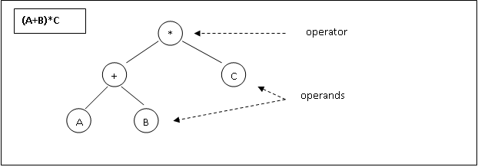
An expression tree is built up from the operands and operators of an expression by placing the operands as leaves of a binary tree and operators as the interior nodes (or as parents).

Slide 3
How to build an expression tree:
Convert the mathematical expression into prefix or postfix.
Construct the expression tree.

Slide 4
Example
Expression : A + B * C
Solution 1:
  Convert mathematical expression to prefix : + A * B C
  Construct the expression tree.
    starts from left

Slide 5
Example
  Rule:
  Pre Order:
  Construct the expression tree starts from left
  Root/node = operator
  Leaf = operand
operator = root/node
Expression : A + B * C , preorder : + A * B C
+

Slide 6
Example
  Rule:
  Pre Order:
  Construct the expression tree starts from left
  Root/node = operator
  Leaf = operand
Operand = leaf
Expression : A + B * C , preorder : + A * B C
+
A

Slide 7
Example
  Rule:
  Pre Order:
  Construct the expression tree starts from left
  Root/node = operator
  Leaf = operand
operand = leaf
Expression : A + B * C , preorder : + A * B C
+
A
*
√
B
C

Slide 8
Example
  Rule:
  Pre Order:
  Construct the expression tree starts from left
  Root/node = operator
  Leaf = operand
operator = node
Expression : A + B * C , preorder : + A * B C
+
A
*

Slide 9
Example
  Rule:
  Pre Order:
  Construct the expression tree starts from left
  Root/node = operator
  Leaf = operand
operand = leaf
Expression : A + B * C , preorder : + A * B C
+
A
*
B

Slide 10
Example
  Rule:
  Pre Order:
  Construct the expression tree starts from left
  Root/node = operator
  Leaf = operand
operand = leaf
Expression : A + B * C , preorder : + A * B C
+
A
*
B
X
Because B = operand , must be a leaf
C

Slide 11
Example
Expression : A + B * C
Solution 2:
  Convert mathematical expression to postorder : A B C * +
  Construct the expression tree.
    starts from right

Slide 12
Example
  Rule:
  Pre Order:
  Construct the expression tree starts from right
  Root/node = operator
  Leaf = operand
operator = root/node
Expression : A + B * C, postorder : A B C * +
+

Slide 13
Example (pg 83)
  Rule:
  Pre Order:
  Construct the expression tree starts from right
  Root/node = operator
  Leaf = operand
operator = root/node
Expression : A + B * C, postorder : A B C * +
+
*

Slide 14
Example
  Rule:
  Pre Order:
  Construct the expression tree starts from right
  Root/node = operator
  Leaf = operand
operand = leaf
Expression : A + B * C, postorder : A B C * +
+
*
C

Slide 15
Example
  Rule:
  Pre Order:
  Construct the expression tree starts from right
  Root/node = operator
  Leaf = operand
operand = leaf
Expression : A + B * C, postorder : A B C * +
+
*
C
B

Slide 16
Example
  Rule:
  Pre Order:
  Construct the expression tree starts from right
  Root/node = operator
  Leaf = operand
operand = leaf
Expression : A + B * C, postorder : A B C * +
+
A
*
C
B

