Slide 1

Queue
Examples of Program

Slide 2
Example 1
Queue intQ= new Queue();

Slide 3
Example 1
intQ
Queue intQ= new Queue();
null
firstNode
lastNode

Slide 4
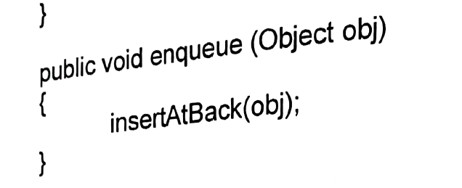
Example 1
intQ
intQ
Queue intQ= new Queue();
10
null
//insert element into intQ
intQ.enqueue(new Integer (10);
firstNode
firstNode
lastNode
lastNode

Slide 5
Example 1
intQ
Queue intQ= new Queue();
10
11
null
//insert element into intQ
intQ.enqueue(new Integer (10);
intQ.enqueue(new Integer (11);
firstNode
lastNode

Slide 6
Example 1
intQ
Queue intQ= new Queue();
10
11
12
null
//insert element into intQ
intQ.enqueue(new Integer (10);
intQ.enqueue(new Integer (11);
intQ.enqueue(new Integer (12);
firstNode
lastNode

Slide 7
Example 1
intQ
Queue intQ= new Queue();
10
11
12
13
//insert element into intQ
intQ.enqueue(new Integer (10);
intQ.enqueue(new Integer (11);
intQ.enqueue(new Integer (12);
intQ.enqueue(new Integer (13);
firstNode
null
lastNode

Slide 8
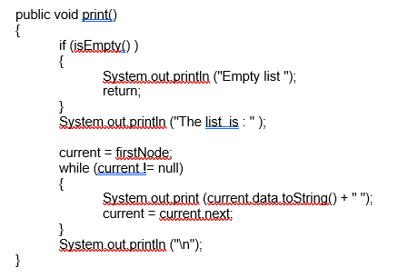
Example 1
intQ
Queue intQ= new Queue();
10
11
12
13
//insert element into intQ
intQ.enqueue(new Integer (10);
intQ.enqueue(new Integer (11);
intQ.enqueue(new Integer (12);
intQ.enqueue(new Integer (13);
firstNode
null
lastNode
//print all element
intQ. print
Inherit from Linked List class
The list is:
10 11 12 13

Slide 9
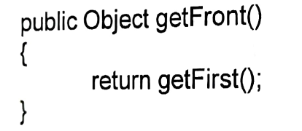
Example 1 - cont
//get and print the first element
System.out.println(“First element : “
+ intQ.getFront().toString() + “\n”);
intQ
10
11
12
13
firstNode
null
lastNode
First element
10
The list is:
10 11 12 13
First element :10

Slide 10
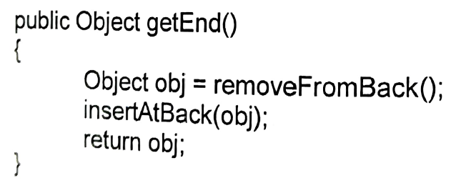
Example 1 - cont
//get and print the last element
System.out.println(“Last element : “
+ intQ.getEnd().toString() + “\n”);
intQ
10
11
12
13
firstNode
null
lastNode
Last element
13
The list is:
10 11 12 13
First element : 10
Last element : 13

Slide 11
Example 1 - cont
//display all elements and remove from queue
intQ
10
11
12
13
while (!intQ.isEmpty())
{
num=Integer.parseInt(intQ.dequeue().
toString());
System.out.println(num + “ dequeued);
intQ.print();
}
firstNode
null
lastNode

Slide 12
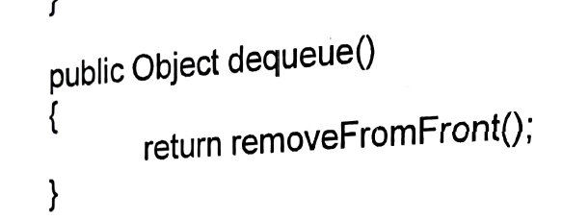
Example 1 - cont
//display all elements and remove from queue
intQ
10
11
12
13
while (!intQ.isEmpty())
{
num=Integer.parseInt(intQ.dequeue().
toString());
System.out.println(num + “ dequeued);
intQ.print();
}
num
firstNode
null
lastNode

Slide 13
Example 1 - cont
//display all elements and remove from queue
intQ
10
11
12
13
while (!intQ.isEmpty())
{
num=Integer.parseInt(intQ.dequeue().
toString());
System.out.println(num + “ dequeued);
intQ.print();
}
num
firstNode
null
lastNode
10 dequeue

Slide 14
Example 1 - cont
//display all elements and remove from queue
intQ
11
12
13
while (!intQ.isEmpty())
{
num=Integer.parseInt(intQ.dequeue().
toString());
System.out.println(num + “ dequeued);
intQ.print();
}
firstNode
null
lastNode
10 dequeue
The list is 11 12 13

Slide 15
Example 1 - cont
//display all elements and remove from queue
intQ
11
12
13
while (!intQ.isEmpty())
{
num=Integer.parseInt(intQ.dequeue().
toString());
System.out.println(num + “ dequeued);
intQ.print();
}
firstNode
null
lastNode
10 dequeue
The list is 11 12 13

Slide 16
Example 1 - cont
//display all elements and remove from queue
intQ
11
12
13
while (!intQ.isEmpty())
{
num=Integer.parseInt(intQ.dequeue().
toString());
System.out.println(num + “ dequeued);
intQ.print();
}
num
firstNode
null
lastNode
10 dequeue
The list is 11 12 13

Slide 17
Example 1 - cont
//display all elements and remove from queue
intQ
11
12
13
while (!intQ.isEmpty())
{
num=Integer.parseInt(intQ.dequeue().
toString());
System.out.println(num + “ dequeued);
intQ.print();
}
num
firstNode
null
lastNode
10 dequeue
The list is 11 12 13
11 dequeue

Slide 18
Example 1 - cont
//display all elements and remove from queue
intQ
12
13
while (!intQ.isEmpty())
{
num=Integer.parseInt(intQ.dequeue().
toString());
System.out.println(num + “ dequeued);
intQ.print();
}
firstNode
null
lastNode
10 dequeue
The list is 11 12 13
11 dequeue
The list is 12 13

Slide 19
Example 1 - cont
//display all elements and remove from queue
intQ
12
13
while (!intQ.isEmpty())
{
num=Integer.parseInt(intQ.dequeue().
toString());
System.out.println(num + “ dequeued);
intQ.print();
}
firstNode
null
lastNode
10 dequeue
The list is 11 12 13
11 dequeue
The list is 12 13

Slide 20
Example 1 - cont
firstNode
//display all elements and remove from queue
intQ
12
13
while (!intQ.isEmpty())
{
num=Integer.parseInt(intQ.dequeue().
toString());
System.out.println(num + “ dequeued);
intQ.print();
}
num
null
lastNode
10 dequeue
The list is 11 12 13
11 dequeue
The list is 12 13

Slide 21
Example 1 - cont
firstNode
//display all elements and remove from queue
intQ
12
13
while (!intQ.isEmpty())
{
num=Integer.parseInt(intQ.dequeue().
toString());
System.out.println(num + “ dequeued);
intQ.print();
}
num
null
lastNode
10 dequeue
The list is 11 12 13
11 dequeue
The list is 12 13
12 dequeue

Slide 22
Example 1 - cont
firstNode
//display all elements and remove from queue
intQ
13
while (!intQ.isEmpty())
{
num=Integer.parseInt(intQ.dequeue().
toString());
System.out.println(num + “ dequeued);
intQ.print();
}
null
lastNode
10 dequeue
The list is 11 12 13
11 dequeue
The list is 12 13
12 dequeue
The list is 13

Slide 23
Example 1 - cont
//display all elements and remove from queue
intQ
num
13
while (!intQ.isEmpty())
{
num=Integer.parseInt(intQ.dequeue().
toString());
System.out.println(num + “ dequeued);
intQ.print();
}
firstNode
null
lastNode
10 dequeue
The list is 11 12 13
11 dequeue
The list is 12 13
12 dequeue
The list is 13

Slide 24
Example 1 - cont
//display all elements and remove from queue
intQ
num
13
while (!intQ.isEmpty())
{
num=Integer.parseInt(intQ.dequeue().
toString());
System.out.println(num + “ dequeued);
intQ.print();
}
firstNode
null
lastNode
10 dequeue
The list is 11 12 13
11 dequeue
The list is 12 13
12 dequeue
The list is 13
13 dequeue

Slide 25
Example 1 - cont
//display all elements and remove from queue
intQ
while (!intQ.isEmpty())
{
num=Integer.parseInt(intQ.dequeue().
toString());
System.out.println(num + “ dequeued);
intQ.print();
}
firstNode
null
lastNode
10 dequeue
The list is 11 12 13
11 dequeue
The list is 12 13
12 dequeue
The list is 13
13 dequeue
Empty list

Slide 26
Example 2
Queue qNum=new Queue();
//insert into qNum
for(int i=1;i<=5;i++){
String num=JOptionPane.showInputDialog("Enter a number");
qNum.enqueue(num);
}
//continue……
qNum
12
2
7
10
8

Slide 27
Example 2
int sum=0;
Queue qTemp=new Queue();
sum
while(!qNum.isEmpty()){
0
Object obj=qNum.dequeue();
no
int no= Integer.parseInt((String)obj);
2
obj
qNum
2
8
7
10
12
qTemp

Slide 28
Example 2
int sum=0;
Queue qTemp=new Queue();
sum
while(!qNum.isEmpty()){
2
Object obj=qNum.dequeue();
no
int no= Integer.parseInt((String)obj);
2
sum+=no;
qTemp.enqueue(obj);
}
obj
qNum
2
8
7
10
12
qTemp
2

Slide 29
Example 2
int sum=0;
Queue qTemp=new Queue();
sum
while(!qNum.isEmpty()){
2
Object obj=qNum.dequeue();
no
int no= Integer.parseInt((String)obj);
2
sum+=no;
qTemp.enqueue(obj);
}
qNum
7
8
10
12
qTemp
2

Slide 30
Example 2
int sum=0;
Queue qTemp=new Queue();
sum
while(!qNum.isEmpty()){
2
Object obj=qNum.dequeue();
no
int no= Integer.parseInt((String)obj);
2
sum+=no;
qTemp.enqueue(obj);
}
obj
qNum
7
8
10
12
qTemp
2

Slide 31
Example 2
int sum=0;
Queue qTemp=new Queue();
sum
while(!qNum.isEmpty()){
2
Object obj=qNum.dequeue();
no
int no= Integer.parseInt((String)obj);
7
sum+=no;
qTemp.enqueue(obj);
}
obj
qNum
7
8
10
12
qTemp
2

Slide 32
Example 2
int sum=0;
Queue qTemp=new Queue();
sum
while(!qNum.isEmpty()){
9
Object obj=qNum.dequeue();
no
int no= Integer.parseInt((String)obj);
7
sum+=no;
qTemp.enqueue(obj);
}
obj
qNum
7
8
10
12
qTemp
2

Slide 33
Example 2
int sum=0;
Queue qTemp=new Queue();
sum
while(!qNum.isEmpty()){
9
Object obj=qNum.dequeue();
no
int no= Integer.parseInt((String)obj);
7
sum+=no;
qTemp.enqueue(obj);
}
obj
qNum
7
8
10
12
qTemp
2
7

Slide 34
Example 2
int sum=0;
Queue qTemp=new Queue();
sum
while(!qNum.isEmpty()){
17
Object obj=qNum.dequeue();
no
int no= Integer.parseInt((String)obj);
8
sum+=no;
qTemp.enqueue(obj);
}
obj
qNum
8
10
12
qTemp
2
7
8

Slide 35
Example 2
int sum=0;
Queue qTemp=new Queue();
sum
while(!qNum.isEmpty()){
27
Object obj=qNum.dequeue();
no
int no= Integer.parseInt((String)obj);
10
sum+=no;
qTemp.enqueue(obj);
}
obj
qNum
10
12
qTemp
2
7
8
10

Slide 36
Example 2
int sum=0;
Queue qTemp=new Queue();
sum
while(!qNum.isEmpty()){
39
Object obj=qNum.dequeue();
no
int no= Integer.parseInt((String)obj);
12
sum+=no;
qTemp.enqueue(obj);
}
obj
qNum
12
qTemp
2
7
8
10
12

Slide 37
Example 2
int sum=0;
Queue qTemp=new Queue();
sum
while(!qNum.isEmpty()){
39
Object obj=qNum.dequeue();
int no= Integer.parseInt((String)obj);
sum+=no;
qTemp.enqueue(obj);
}
qNum
qTemp
2
7
8
10
12

Slide 38
Queue and Objects
Please do on your own. Refer Queue and Linked List notes

