Slide 1
Stack
STACK APPLICATION

Slide 2
STACK APPLICATION
Arithmetic operation
Recursion method

Slide 3
Arithmetic operation
Priority | Operator | Order if exist together
Highest | ( ) | Left to right
 | $ | Right to left
 | * / | Left to right
Lowest | + - | Left to right

Slide 4
Arithmetic Expression (Binary):
Infix – operand operator operand. Example : A+B
Prefix - operator operand operand. Example : +AB
Postfix - operand operand operator. Example : AB+

Slide 5
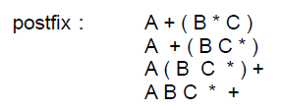
Example: Postfix expression

Slide 6
Example: Postfix expression
Highest priority

Slide 7
Example : Postfix expression
Convert to postfix expression

Slide 8
Example : Postfix expression
Highest priority

Slide 9
Example : Postfix expression
Convert to postfix expression

Slide 10
Example : Postfix expression
Postfix expression

Slide 11
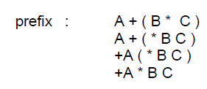
Example : Prefix expression
Highest priority

Slide 12
Example : Prefix expression
Convert to prefix expression

Slide 13
Example : Prefix expression
Highest priority

Slide 14
Example : Prefix expression
Convert to prefix expression

Slide 15
Example : Prefix expression
Prefix expression

